Slide 1


Introduction To
Data Science
Introduction To Data Science
“Hiding within those mounds of data is the knowledge that could change the life of a patient, or change the world”

Slide 2

The Hype surrounding Data Science in the Media
Data Science all over the Media
Media outlets such as :
Le Monde
NY Times
Criteo
World Bank

Slide 3


Les Données, Puissance
du Future Le Monde
Data Science all over the Media
“Les données en elles-mêmes offrent un potentiel extraordinaire que l'on commence à exploiter. Elles permettent de générer des connaissances, qui étaient soit hors d'atteinte, soit inexistantes, parce que hors du domaine du pensable”

Slide 4


Big Data in More Hands
Data Science all over the Media
“Software that captures lots of data and uses it to make predictions has mostly been the province of engineers skilled in arcane databases and statisticians, As the business gets bigger, however, software makers are domesticating their products in the hope they will prove attractive to a broader population”

Slide 5

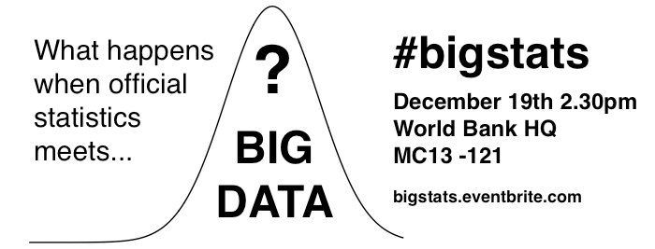
What happens when big data meets official statistics?
Data Science all over the Media
“This is an exciting time to be in the data business. There have never been more groups, from such different backgrounds, with a passion for producing and using data for the public good.”

Slide 6
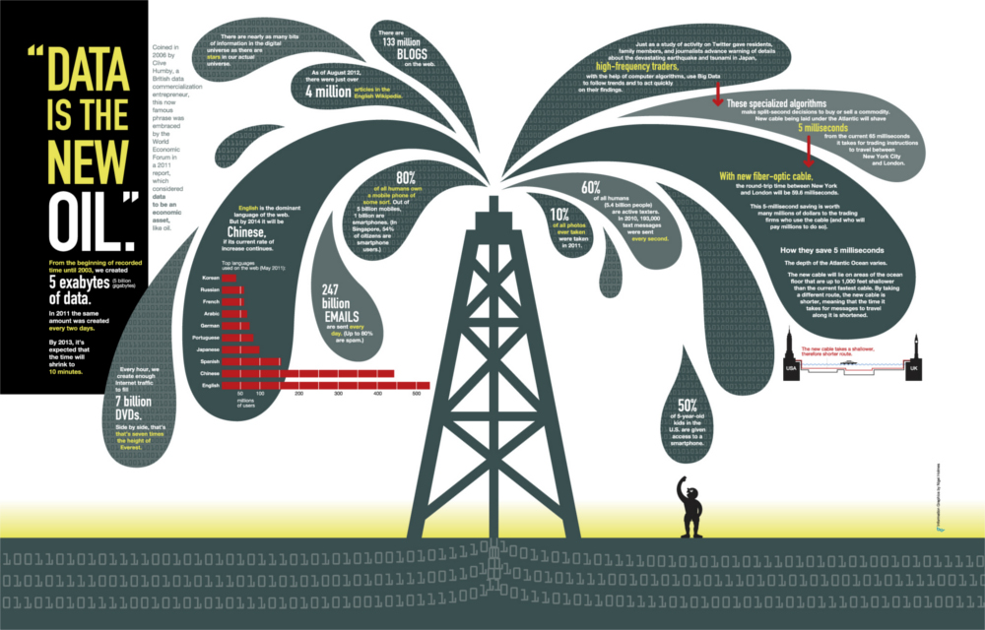

Data is the new oil that fuels society
Data Science all over the Media

Slide 7


Where is Data Exploited Today?
Examples of Data Science applications and exploitation
It's Hidden in Plain Sight

Slide 8




Search Engines
Examples of Data Science applications and exploitation
From the Common to lesser known

Slide 9


Recommendation systems
Examples of Data Science applications and exploitation

Slide 10


Targeted Advertisement
Examples of Data Science applications and exploitation

Slide 11
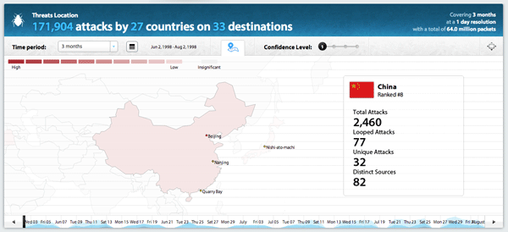
Intrusion Detection
Examples of Data Science applications and exploitation

Slide 12
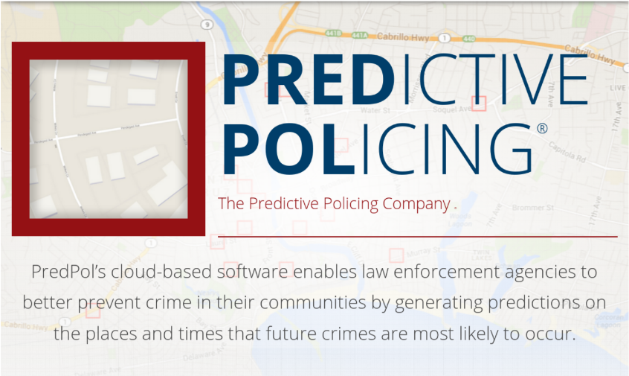
Crime Prevention
Examples of Data Science applications and exploitation

Slide 13
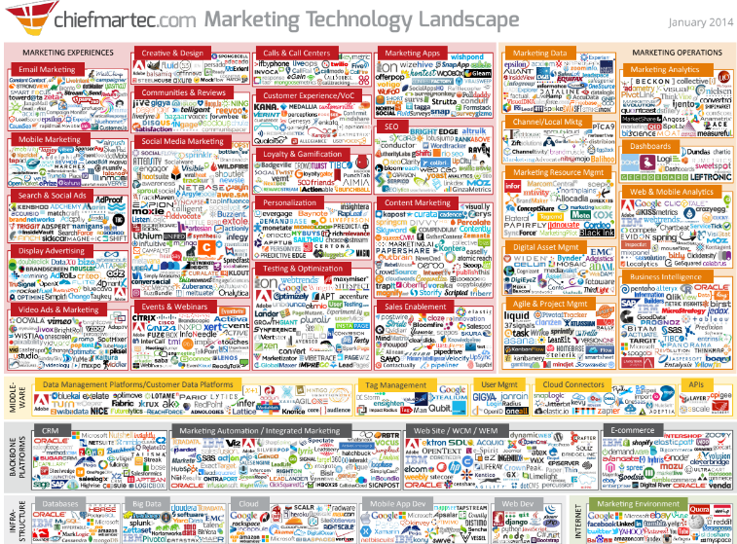
Marketing
Examples of Data Science applications and exploitation

Slide 14
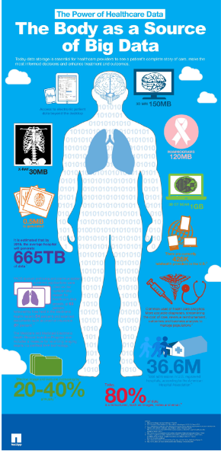
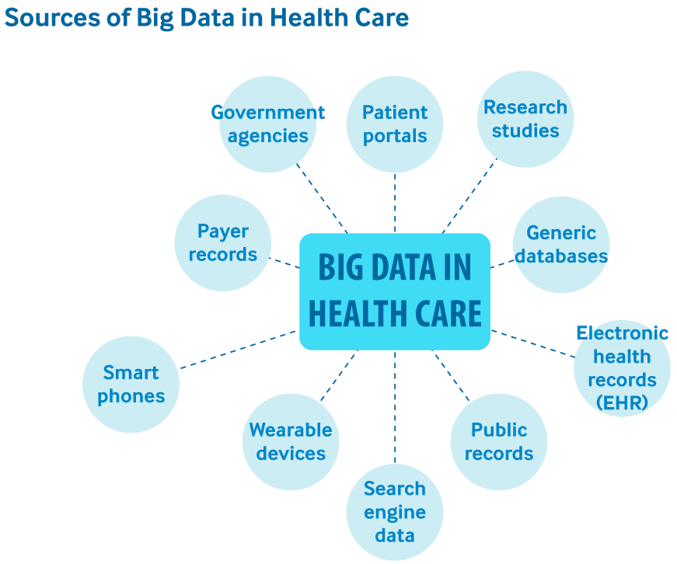
Health and Medicine
Examples of Data Science applications and exploitation

Slide 15
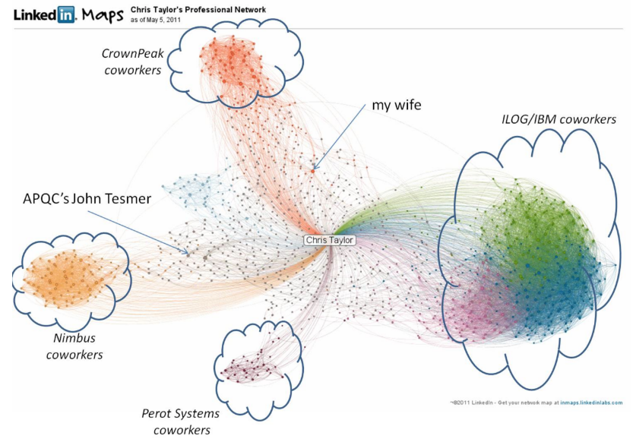
LinkedIn
Examples of Data Science applications and exploitation

Slide 16
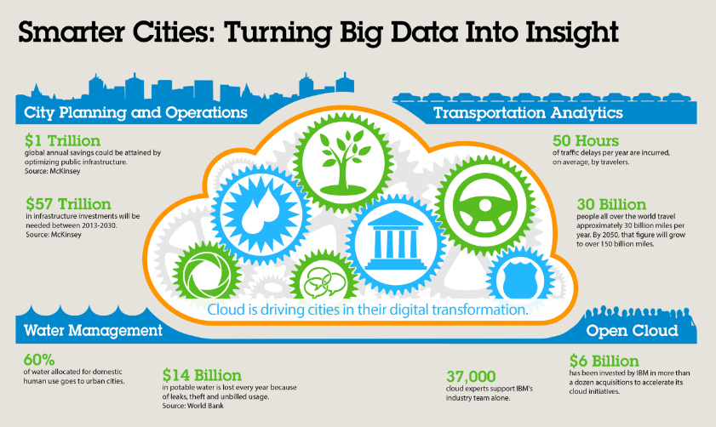
Smart City
Examples of Data Science applications and exploitation

Slide 17
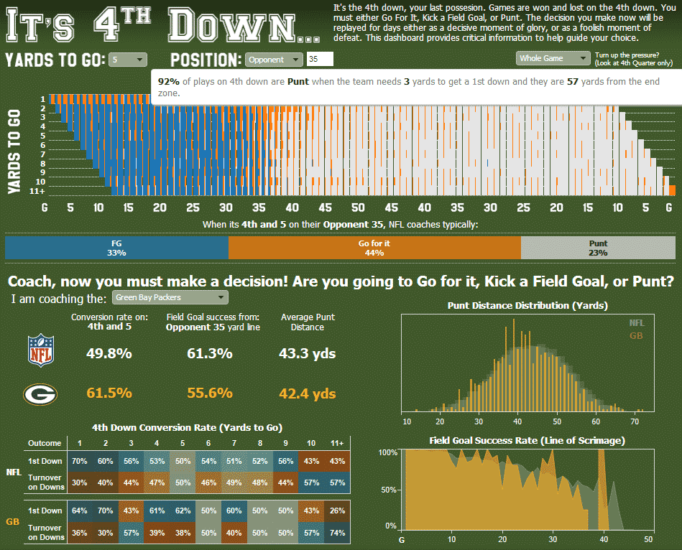
Sports
Examples of Data Science applications and exploitation

Slide 18

Real time example Real time Bidding
Real Time Example
A Run down of a real-life Use Case

Slide 19
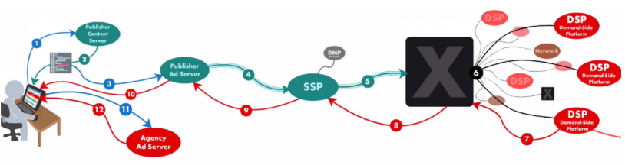
Examples of Data Science applications and exploitation
1. A customer visits a webpage with his browser : a complex process
of content selection and delivery begins.
An advertiser might want to display an ad to this customer on the
webpage he is going to
The webpage belongs to a publisher. The publisher delivers contents : news, music, information, sports, etc. This content draws an audience
The publisher sells ad space to advertisers who want to reach that audience

Slide 20
Examples of Data Science applications and exploitation
2. The customer visits a publisher’s webpage: the browser opens a connection to the publisher’s content server. It returns the content for the page (html code).
The html code describing this content is retrieved by the browser, and it starts to render an interpret it.
But... there is a line in this html code that says “follow this URL to retrieve ad content”

Slide 21
Examples of Data Science applications and exploitation
3. The publisher has an ad server: it answers the request by considering possibilities: can I put an ad for my premium buyers ? Do I have data about this consumer viewing my content? (it could help me to decide to which buyer I could give this display opportunity). Only logical rules apply (no machine-learning here).
The ad display opportunity is not premium, and this space or type of customer is not already reserved by a buyer. Publisher’s ad server puts this opportunity of ad display in the open ad market.

Slide 22
Examples of Data Science applications and exploitation
4. The publisher ad server connects to an SSP (Supply-Side Platform). This platform monetizes its programmable display inventory.
The SSP asks: have I already seen this consumer before ? Do I have additional data on him? The SSP requests extra information to a DMP (Data-Management Platform) about the user: profiling, audience segments, etc. Here machine learning is applied.
5. Using this information, the SSP sends the ad request to an ad-exchange

Slide 23
Examples of Data Science applications and exploitation
6. Meanwhile, the ad-exchange is connected and exchanges with many potential buying systems: DSP (Demand-Side Platform), ad-networks, even other ad-exchange networks.
Ad-network and DSP can have pre-cached bid: I’m paying 1$ for 1000 displays of 25years-old males in France, I buy 100 displays as soon as the price is below some threshold (like a broker).
If no pre-cached bids, the ad-exchange says: no direct buyer for this display. Let’s us an auction rule! The RTB (Real Time Bidding) begins.

Slide 24
Examples of Data Science applications and exploitation
6. RTB: buyers have 10ms (!) to give a price to the ad-exchange. Buyers assess in real-time how willing they are to display an ad to this customer.
Machine learning is used here, but only the prediction step, e.g. to assess the probability that the customer will click on some ads. The model must contain few parameters to answer quickly: the use of feature selection in the training step is crucial here.

Slide 25
Examples of Data Science applications and exploitation
7. The ad-exchange selects the highest bidder. The winning DSP gives instruction to the ad-exchange to retrieve the ad creative.
8. The ad-exchange passes these instructions to the SSP
9. The SSP send the request to the publisher ad server
10. The publisher ad server responds to the still existing http connection of the browser,
11. 12. and tells the browser to go to the agency’s ad server to download the ad.

Slide 26
Examples of Data Science applications and exploitation
Now the ad can be displayed in the browser.
Full process takes < 100ms !
Where is data science:
DMP side, to cluster audience into marketing segments and to profile customers: clustering and classification
Buyer’s side (DSP, ad-network) to compute the price proposed for RTB. Need to estimate the probability of a click on ads: regression and classification

Slide 27
Examples of Data Science applications and exploitation
Some numbers for a large web-advertisement company:
10 million prediction of click probability per second
answers within 10ms
stores 20Terabytes of data daily

Slide 28

The Data Science Eco System
The Data Science Eco System
A New Context

Slide 29
The Data Science Eco System
The Data Science Eco System
- Cloud Computing
- Graphical Processing Units (GPUs)
- Huge Volume
- Huge Variety
Affordable Computational Units
Data Everywhere
A Growing academic and Industrial Interest

Slide 30
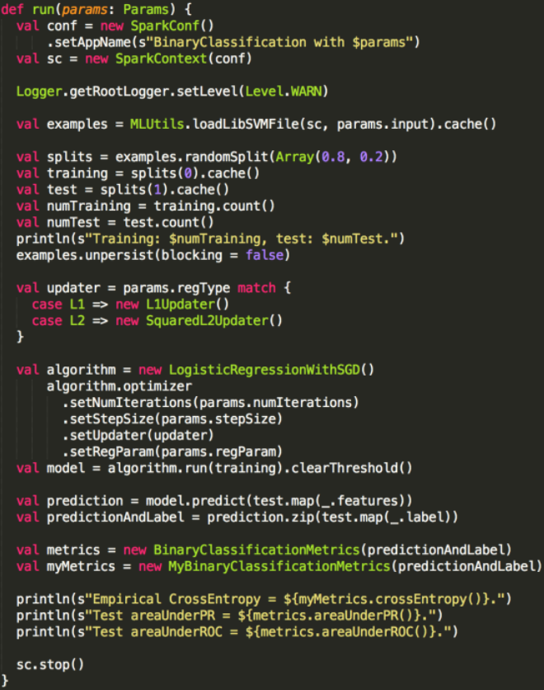


Examples of off the shelve solutions
The Data Science Eco System
Apache Spark
Amazon Web Services

Slide 31
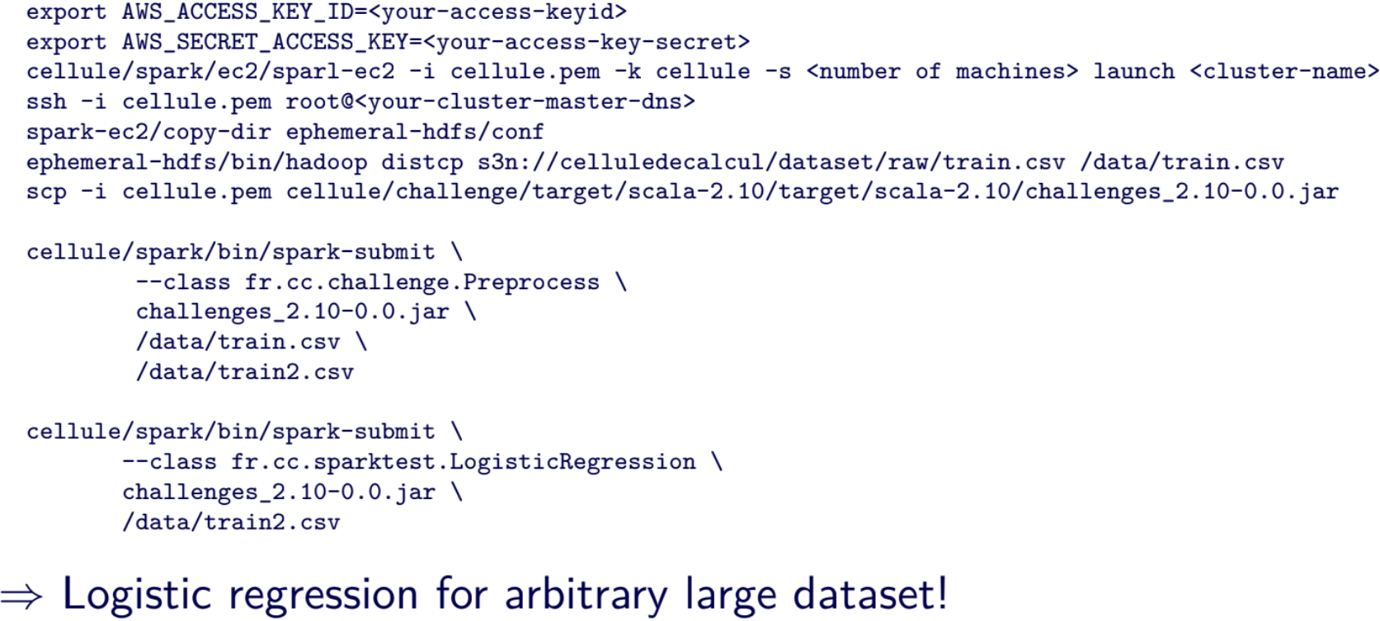
Examples of off the shelve solutions
The Data Science Eco System
Apache Spark
Amazon Web Services

Slide 32
A Complex Eco System
The Data Science Eco System
Business Predictive Models
Industry specific Predictive Models
Customer Predictive Models
Real Time analytics
(Ex: Splunk, JackBe)
Big Data
Solutions
Big Data Machine Learning Engine
(Ex: IMB, SKYTREE)
Big Data
Technology
Application
(Ex: Web, Web services,
Thick Client)
Big Data
Software Platform
(Ex: Hadoop, Cloudera, Hortonworks)
Big Data
Data Stores
Big Data
[Structured and Unstructured]
Ex : mongoDB, REDIS, Cassandra, Hana

Slide 33
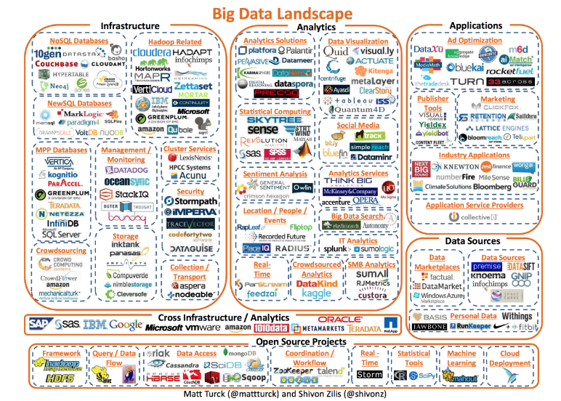
A Complex Eco System
The Data Science Eco System

Slide 34
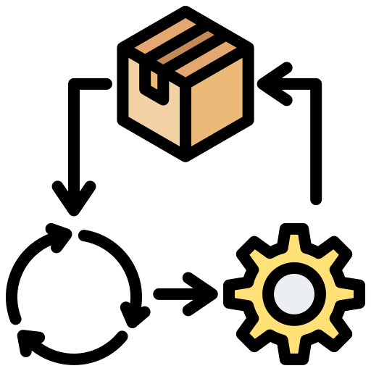
The Data Cycle
Data Cycle
From Data to Decision

Slide 35
The Data Cycle
Data Cycle
Acquisition, Cleaning, Storage
Data
Integration
Analysis
Visualisation and Interface
Decision Process
Data / Information Flow Vision

Slide 36
The Data Cycle
Data Cycle
Practical Issues
Acquisition, Cleaning, Storage
Data
Integration
Analysis
Visualisation and Interface
Decision Process
Data / Information Flow Vision
Goal Oriented

Slide 37
Data
Data Cycle
Raw material:
Structured and unstructured data (Variety)
Data quality issue (Veracity)
Quantity (Volume and Velocity)
Various sources:
Open data,
Proprietary data

Slide 38
Acquisition, Cleaning, Storage and Integration
Data Cycle
Get the data from the sources.
Storage issue and availability for processing.
Cleaning and formatting.
Integration: Data preparation for analysis.
Time consuming!

Slide 39
Analysis
Data Cycle
Extract information from the data
Statistics/Machine learning
Big Data: hardware is the limit (time/volume)

Slide 40
Visualization and Interface
Data Cycle
Reporting part: Visualization, text...
Also used for data exploration
Very important aspect!

Slide 41
Decision and goal-oriented analysis
Data Cycle
Better decisions: Value
Need to answer a problem/question!
Need to formalize the problem: no answer
without a question!
Feedback everywhere...

Slide 42
The Data Cycle
Data Cycle
Better decisions: Value
Need to answer a problem/question!
Need to formalize the problem: no answer
without a question!
Feedback everywhere...

Slide 43
Real Data Cycle
Data Cycle
Acquisition, Cleaning, Storage
Data
Integration
Analysis
Visualisation and Interface
Decision Process
Data / Information Flow Vision

Slide 44
Real Data Cycle
Data Cycle
Practical Issues
Acquisition, Cleaning, Storage
Data
Integration
Analysis
Visualisation and Interface
Decision Process
Data / Information Flow Vision
Goal Oriented

Slide 45
Real Data Cycle
Data Cycle
Practical Issues
Acquisition, Cleaning, Storage
Data
Integration
Analysis
Visualisation and Interface
Decision Process
Data / Information Flow Vision
Goal Oriented
Iterative and interactive process

Slide 46
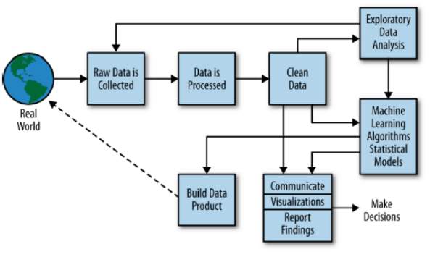
Doing Data Science
Data Cycle
Doing Data Science: Straight talk from the frontline.
Rachel Schutt, Cathy O’Neil
O’Reilly

Slide 47

Data Science Project
Data Science Project
A 7 Step Program

Slide 48
Data Science Project
Data Science Project
1. Identify the problem
Type of problems and metric used to measure success
Identify key people within your organization and outside
Get specifications, requirements, priorities, budgets
How accurate the solution needs to be?
Do we need all the data?
Outsourcing?

Slide 49
Data Science Project
Data Science Project
2. Identify available data sources
Extract and check sample data / Perform Exploratory Data
Analysis
Assess quality of data, and value available in data
Identify data glitches, find work-around
Data quality improvement?
Verify with field expert that you understand the data
Infrastructure?

Slide 50
Data Science Project
Data Science Project
3. Identify if additional data sources are needed
What? How much? How to?
Real time?
Do we need experimental design?

Slide 51
Data Science Project
Data Science Project
4. Data preparation and analyses
Data preparation and cleaning
Explore methodologies
Select variables and models
Detect / remove outliers
Validate chosen methodology
Measure accuracy, provide confidence intervals
Provide visualization and ask for feedback

Slide 52
Data Science Project
Data Science Project
5. Implementation, development
FSSRR: Fast, simple, scalable, robust, re-usable
Debugging
Need to create an API to communicate with other apps?

Slide 53
Data Science Project
Data Science Project
6. Communicate results
Integration and visualization
Discuss potential improvements (with cost estimates)
Provide training
Code and methodology documentation

Slide 54
Data Science Project
Data Science Project
7. Maintenance
Test the model or implementation; stress tests
Regular updates
Outsourcing?

Slide 55

Data Scientists
Data Scientists
Skills
Profiles
Types

Slide 56
Skills
Data Scientists
Business:
Business analysis, market knowledge, product usage, …
Data Management:
Data collection, storage, cleaning, filtering, integration, …
Statistic and Machine Learning:
Data modelling, inference, prediction, pattern recognition, …
Programming:
Software development, Large-scale or parallel data processing, ...
Interface and Data Visualization:
HCI design, visualization, story-telling, …

Slide 57
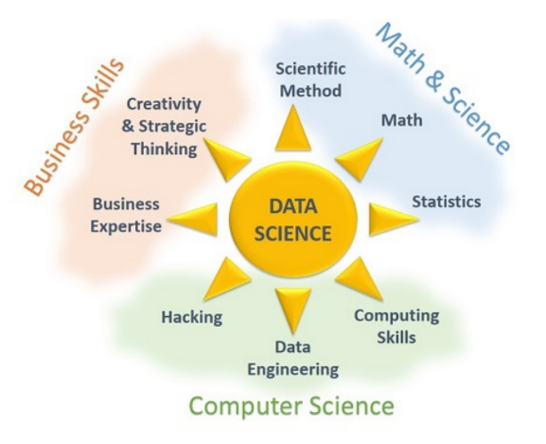
Profiles
Data Scientists
No one masters all the skills

Slide 58
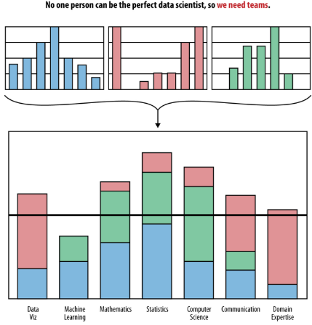
Data Science Team
Data Scientists
Gather people having different skills

Slide 59
Main types of data scientists
Data Scientists
There are the ones...
Strong in statistics: develop new statistical theories for big data: statistical modelling, experimental design, sampling, clustering, data reduction, confidence intervals, testing, modelling, predictive modelling, etc.
Strong in mathematics: operations research, analytic business (inventory management and forecasting, pricing optimization, supply chain, quality control, yield optimization)
Strong in data engineering, Hadoop, database/memory/file systems optimization and architecture, API’s, Analytics as a Service, optimization of data flows

Slide 60
Main types of data scientists
Data Scientists
Strong in computer science (algorithms, computational complexity, optimization)
Strong in business, ROI optimization, decision sciences (dashboards design, metric mix selection and metric definitions, ROI optimization, high-level database design)
Strong in production code development, software engineering

Slide 61
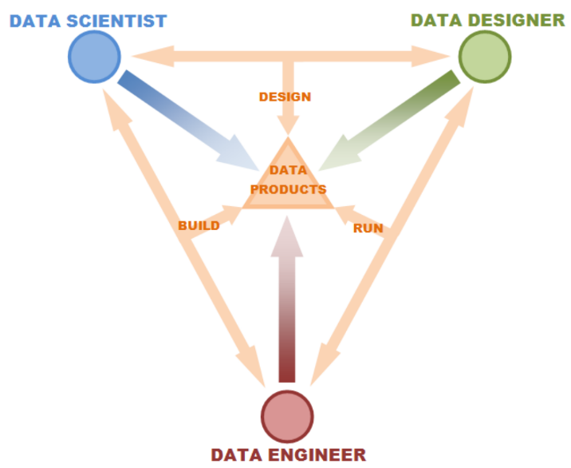
More than data scientists?
Data Scientists

Slide 62


Big Data, Data Science, Statistics
Big Data, Data Science, Statistics

Slide 63

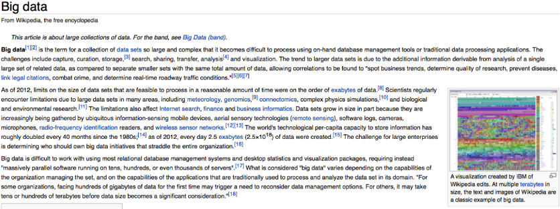
Big Data
Big Data, Data Science, Statistics
Wikipedia

Slide 64
Big Data
Big Data, Data Science, Statistics
Wikipedia
Big data is an all-encompassing term for any collection of data sets so large and complex that it becomes difficult to process using traditional data processing applications.
Data science is the study of the generalizable extraction of knowledge from data, yet the key word is science.
Statistics is the study of the collection, analysis, interpretation, presentation and organization of data.

Slide 65
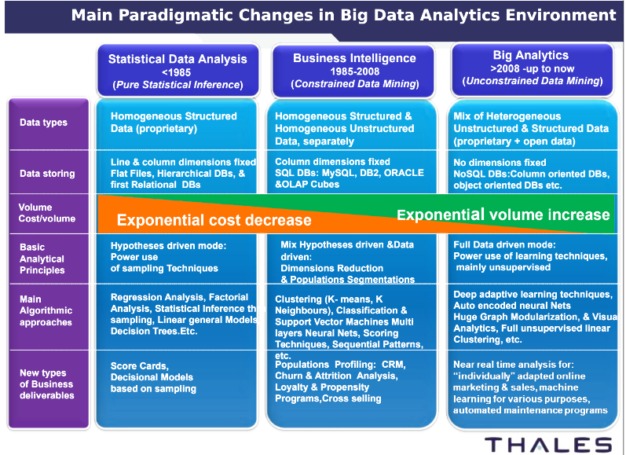
Data Science Evolution
Big Data, Data Science, Statistics

Slide 66
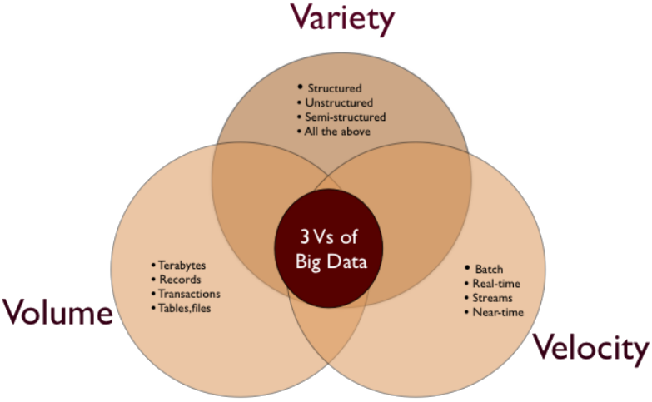
3Vs of Big Data
Big Data, Data Science, Statistics

Slide 67
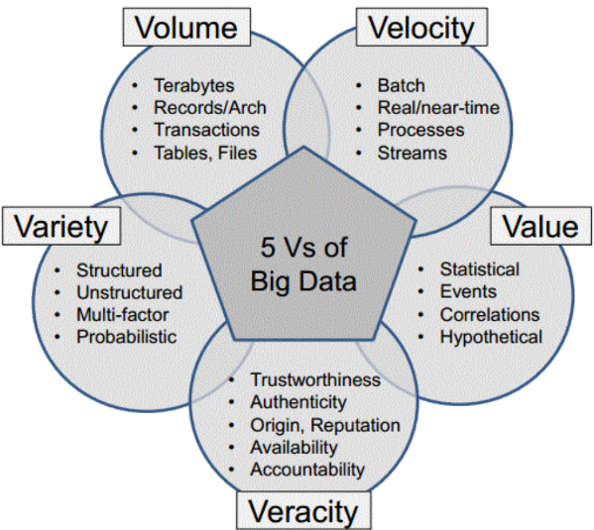
5Vs of Big Data
Big Data, Data Science, Statistics

Slide 68
Data science or statistics?
Big Data, Data Science, Statistics
A vocabulary problem:
Data scientist or Statistician?
Statistics or Data science?

Slide 69
Data science or statistics?
Big Data, Data Science, Statistics
A Possible Answer :
“A Data Scientist is a statistician who lives in San Francisco
Data Science is statistics on Mac
A Data Scientist is someone who is better at statistics than any software engineer and better at software engineering than any statistician”

Slide 70

Computing and Distributed Computing
Computing and Distributed Computing
Computer Architecture

Slide 71
Computer Architecture
Computing and Distributed Computing
Internal Memory
Everything should go through the CPU
Central Processing Unit CPU
Control Unit
CU
Arithmetic
Logic Unit
ALU
Input Devices
Output Devices
Memory
Registers
Cache
External Memory

Slide 72
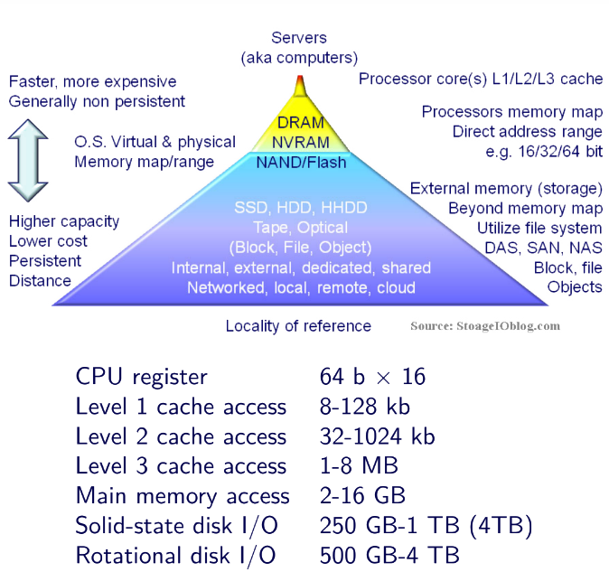
Memories
Computing and Distributed Computing

Slide 73
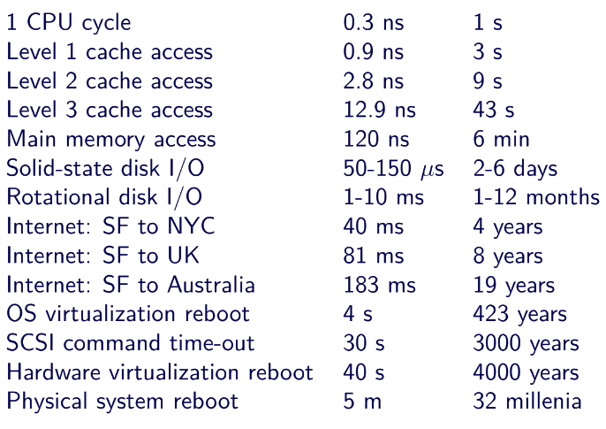
Memories
Computing and Distributed Computing

Slide 74
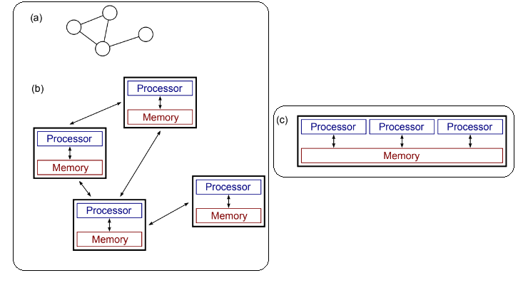
Distributed/Parallel Computing
Computing and Distributed Computing
Distributed (a/b)
Parallel (c)

Slide 75
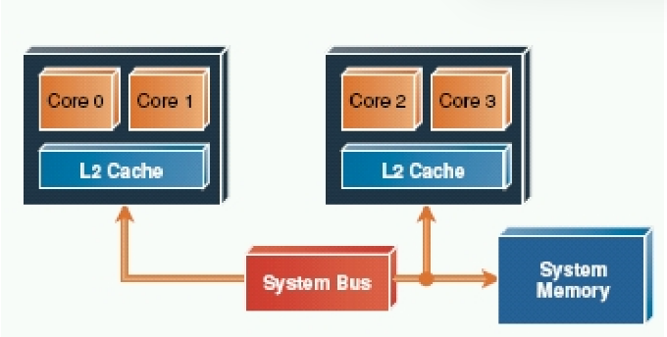
MultiCore
Computing and Distributed Computing
Several processors/cores with the same shared ram.
No too expensive transfer between core.
Strategies:
Independent batch
Parallelization technique limiting information transfer...
System memory limitation!

Slide 76
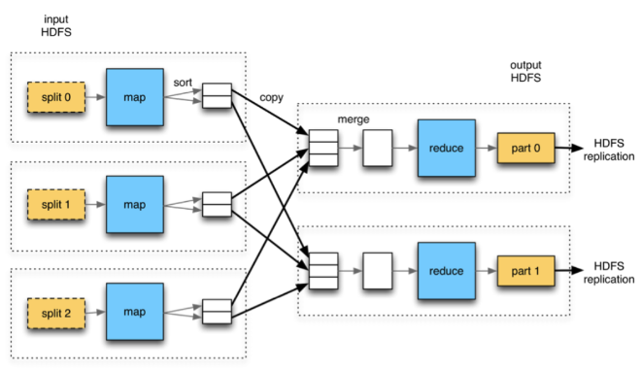
Hadoop and Map/Reduce
Computing and Distributed Computing
Data transfer through disk and networked file system!
Hadoop: Node failure handling and ecosystem.

Slide 77
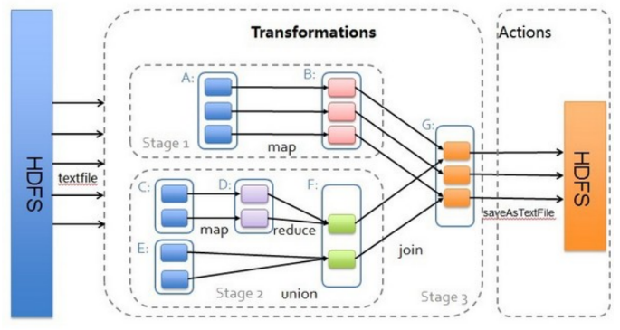
Spark
Computing and Distributed Computing
Spark : Transformations and actions
Strategy: keep everything as much as possible in memory...

Slide 78
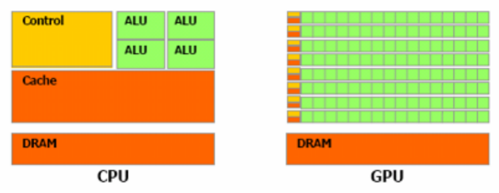
GP-GPU
Computing and Distributed Computing
Combine different processor types...
CPU < DSP < FPGA < ASICS

Slide 79

Data Science Challenges
Data Science Challenges

Slide 80
New Interdisciplinary Challenges
Data Science Challenges
Applied math AND Computer science
Huge importance of domain specific knowledge: physics,
signal processing, biology, health, marketing...
Some joint Math / Computer science challenges
Data acquisition
Unstructured data and their representation
Huge dataset and computation
High dimensional data and model selection
Learning with less supervision
Visualization

Slide 81
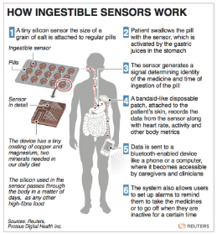
Data acquisition
Data Science Challenges
Some Challenges
How to measure new things?
How to choose what to measure?
How to deal with distributed sensors?
How to look for new sources of Informations?

Slide 82
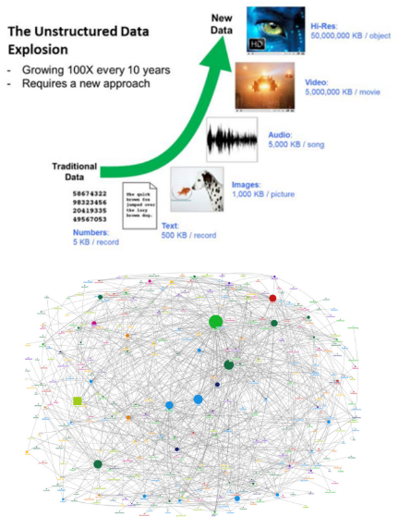
Unstructured Data
Data Science Challenges
Some Challenges
How to store efficiently the data?
How to describe (model) them to be able to process them?
How to combine data of different nature?
How to learn dynamics?

Slide 83
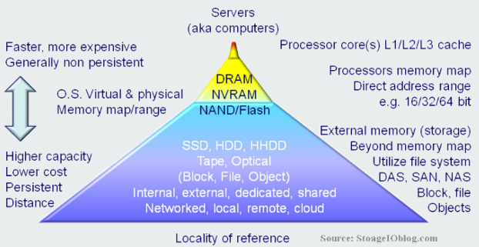
Huge Dataset
Data Science Challenges
Some Challenges
How to take into account the locality of the data?
How to construct distributed architectures?
How to design adapted algorithms?

Slide 84
High Dimensional Data
Data Science Challenges
Some Challenges
How to describe (model) the data?
How to reduce the data dimensionality?
How to select/mix models?

Slide 85
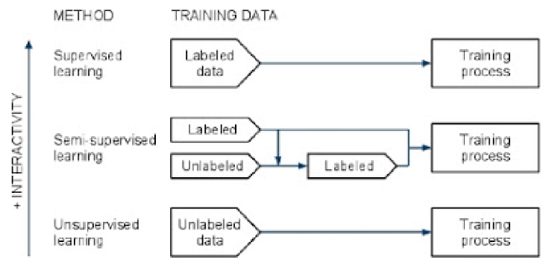
Learning and Supervision
Data Science Challenges
Some Challenges
How to learn with the less possible interactions?
How to learn simultaneously several related tasks?

Slide 86
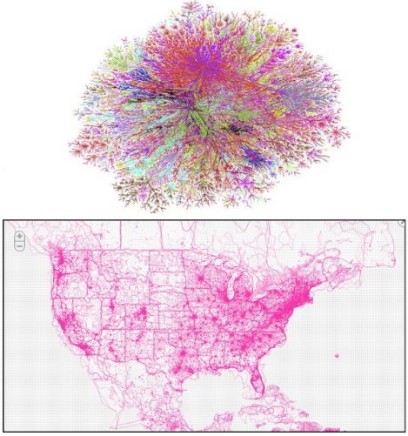
Visualization
Data Science Challenges
Some Challenges
How to look at the data?
How to present results?
How to help taking better informed decision?

Slide 87

Vocabulary of Data Science
Vocabulary of Data Science
Lots of words

Slide 88
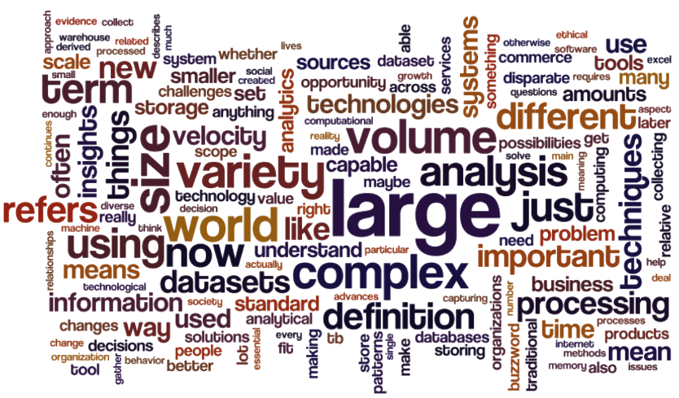
Lots of words
Vocabulary of Data Science

Slide 89
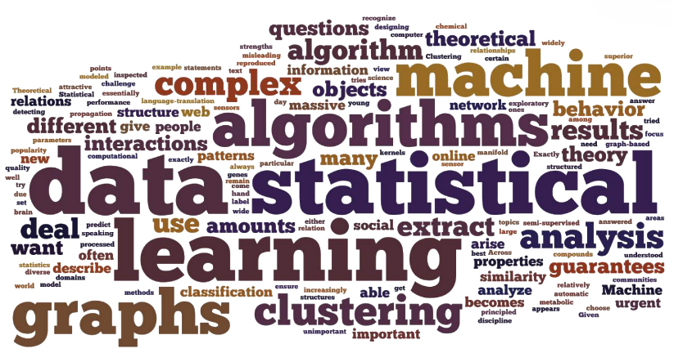
Lots of words
Vocabulary of Data Science

Slide 90
Main Fields
Vocabulary of Data Science
Natural language processing (NLP). Specialization of machine learning and linguistics that builds algorithms to analyse human (natural) language. Example: sentiment analysis on social networks.
Network analysis. Characterize relationships among nodes in a graph or a network, understand the communities, the influence of nodes on the others, understand how information travels in the network. Example: identify key opinion leaders in a social network, identify the information flows in a large company
Predictive modelling. Use of a mathematical model to predict an outcome, e.g., regression, classification, etc. Example. Predict the probability that a customer will churn.

Slide 91
Main Fields
Vocabulary of Data Science
Supervised learning. Machine learning techniques that infer a function or a relationship from a set of training data. Examples: classification, regression
Unsupervised learning. Machine learning techniques that finds structure in unlabelled data. Example: clustering is a part of unsupervised learning
Visualization. Techniques used for representation of data by creating images, diagrams, animations, in order to communicate, understand, explore and improve understanding of data.

Slide 92
Machine Learning
Vocabulary of Data Science
Labels. Characteristics / categories of interest in points of data. This is the information one wants to predict in supervised learning.
Features. A set of information about a point of data (a customer, a company, a country, etc.)
Clustering. Algorithms used in unsupervised learning to assign a group to each data point. Groups are called clusters. Example: customer segmentation in an e-commerce platform
Classification. Algorithms used in supervised learning to predict the labels of data points. It relies on the training of a model or algorithm using labelled data. Keywords: Logistic Regression, SVM, CART, Boosting, etc.
Feature selection. Algorithms in machine learning that select features that best explain an outcome. Example. In biology, find the genetic Informations that best explains a patient’s response to a drug.

Slide 93
Mathematical Concepts
Vocabulary of Data Science
Generalization. Ability of a predictive algorithm to generalize give good predictive results on a sample different than to one used to train the algorithm.
Parameters. A set of coefficients (vectors, matrices), that specifies a model. Example: the mean and standard deviation of a Gaussian distribution
Statistical model. A mathematical formulation that attempts to explain how data is generated. Example: data is generated by a multivariate Gaussian distribution
Likelihood. The probability that data is generated by a model for some parameters choice

Slide 94
Mathematical Concepts
Vocabulary of Data Science
Optimization. Study and design of numerical algorithms used to (but not only) minimize or maximize functions. Example: optimization of a likelihood is called the training step in machine learning.
Goodness-of-fit. A quantity that assesses the closeness of a (trained) model to data. Example. The least-squares error for linear regression.
Over-fitting. Something that must be avoided to have a good predictive performance on new data.
Cross-validation. Splitting of data into several subsets. A model is trained on a subset and tested on another, to check its goodness-of-fit both on data used for training, but on new data as well.

Slide 95
Data Engineering
Vocabulary of Data Science
Structured data. Data structured in fixed fields. Example: relational databases or excel spreadsheets.
Semi-structured data. Data not structured in fixed fields but contain markers to separate data elements. Example: XML or HTML-tagged text.
Unstructured data. Data not structured in fixed fields. Example: books, articles, body of e-mail messages, audio, image and video data, etc.
Metadata. Data that describes the content and context of data: creation, purpose, time and date, author, etc.

Slide 96
Data Engineering
Vocabulary of Data Science
Data fusion and data integration. Set of techniques that integrate and analyse data from multiple sources, instead of analysing single sources of data. Example: combine analysis of social network data with NLP and real-time sales data, to assess the effect of a marketing campaign on customer sentiment and purchases

Slide 97
Databases and Data Processing
Vocabulary of Data Science
Cloud computing. A computing paradigm where computing resources are configured as a distributed system, which provides a service through a network.
Distributed system. Several computers, communicating through a network, used to solve a common storing or computational problem. Aim is higher performance at a lower cost, higher reliability and scalability.
Relational database. A database consisting of collections of tables (relations), namely data are stored in rows and columns. SQL is the most widely used language for managing relational databases.
Non-relational database. A database that does not store data in tables (rows and columns).

Slide 98
Vocabulary of Data Science
Databases and Data Processing
SQL. Acronym for Structured Query Language. It is a computer language designed for managing data in relational databases. Example. insert, query, update, delete data, manage database structures, and control access to data in the database.
NoSQL. A group of database management systems. Data is not stored in tables like in Relational database. It does not rely on the mathematical relationship between tables. It gives a way of storing and retrieving unstructured data quickly.
Hbase. A distributed, non-relational database. It is managed as a project of the Apache Software foundation and a part of Hadoop.

Slide 99
Databases and Data Processing
Vocabulary of Data Science
Hadoop. A framework that supports large scale data processing by allowing the decomposition of large tasks into smaller tasks, that are executed in parallel, on independently slices of the data and then finally merged to answer to the task.
MapReduce. A software framework introduced by Google for processing huge datasets on a distributed system. Implemented in Hadoop. It supports large scale data processing by decomposing large tasks into smaller tasks, executed in parallel, on independent parts of data and finally merged to answer to the task.
Stream processing. Technologies designed to process large real-time streams of event data. Example: high-frequency algorithmic trading, analysis of Twitter data streams

